Slide 1





Mocking
Unit Testing Methods with External Dependencies
High-Quality Code
SoftUni Team
Technical Trainers
Software University
http://softuni.bg

Slide 2

Table of Contents
What is Mocking?
Testing Code with External Dependencies
Inversion of Control Principle
Dependency Injection
Mocking Frameworks
Using Moq

Slide 3
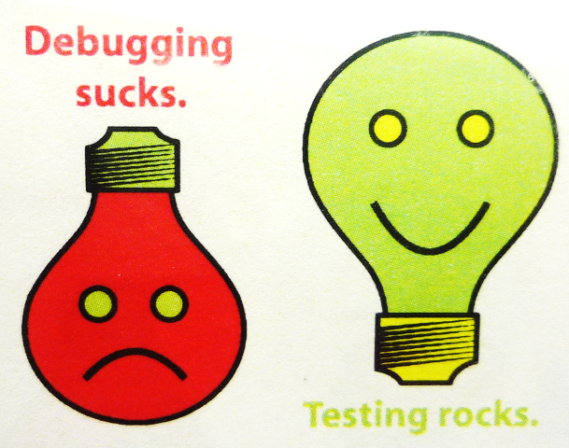
Testable Code

Slide 4
DIP – Dependency Inversion Principle
"Dependency Inversion Principle says that high-level modules should not depend on low-level modules. Both should depend on abstractions."
"Abstractions should not depend on details. Details should depend on abstractions."
Agile Principles, Patterns, and Practices in C#
Goal: decoupling between modules through abstractions
Programming through interfaces

Slide 5
How to Write Testable Code
Inversion of Control Pattern
Decouples the execution of a certain task from implementation
Every module can focus on what it is designed for
Modules make no assumptions about what other systems do but rely on their contracts
Replacing modules has no side effect on other modules
More info at http://en.wikipedia.org/wiki/Inversion_of_control

Slide 6
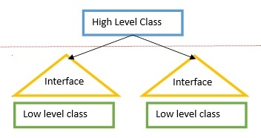

Depend on Abstractions
How it should be?
Classes should declare what they need
Constructors should require dependencies
Dependencies should be abstractions
How to do it
Dependency Injection (DI)
The Hollywood principle "Don't call us, we'll call you!"

Slide 7

Dependency Inversion Principle: How?
Dependency Injection
Dependencies are passed through constructors
Pros
Classes self-documenting requirements
Works well without container
Always valid state
Cons
Many parameters
Some methods may not need everything

Slide 8
Constructor Injection – Example
public class Copy
{
private IReader reader;
private IWriter writer;
public Copy(IReader reader, IWriter writer)
{
this.reader = reader;
this.writer = writer;
}
// Read / write data through the reader / writer
}
var copy = new Copy(new ConsoleReader(), new FileWriter("out.txt"));

Slide 9

Mocking

Slide 10
Mocking
Mocking allows unit testing code with dependencies
Class / method needs to have its dependencies isolated through abstractions
We then pass fake (mocked) dependencies and assert if the tested piece of code has correct behavior
Very helpful technique in data-driven applications where data can be different in every test run

Slide 11
Testing Data-Driven Applications
ExtractImageUrls cannot be reliably tested
Accessing external data can return different results
public class Crawler
{
public IEnumerable<string> ExtractImageUrls(
string pageUrl)
{
var client = new WebClient();
var html = client.DownloadString(pageUrl);
return this.ParseImages(html);
}
private IEnumerable<string> ParseImages(
string html) { ... }
}
Dependency

Slide 12
How to Test a Unit with a Dependency?
Extract said dependency in an interface
Class should receive the interface through dependency injection
Create a mock of the dependency with static behavior (i.e. always returning same data)
Pass mock object to the tested class
Assert if tested class behavior is correct

Slide 13
Testing a Unit with Dependencies
Create dependency interface
Create a class and implement the interface
public interface IHtmlProvider
{
string DownloadHtml(string pageUrl);
}
public class HtmlProvider : IHtmlProvider
{
public string DownloadHtml(string pageUrl)
{
var client = new WebClient();
return client.DownloadString(pageUrl);
}
}
Extract dependency code into the class

Slide 14
Testing a Unit with Dependencies (3)
In the tests project, set up a fake object
public class FakeHtmlProvider : IHtmlProvider
{
public string DownloadHtml(string pageUrl)
{
string fakeHtml = "<html>" +
"<img src=\"nakov.png\"/>" +
"<span>Hello</span>" +
"<img src=\"courses/inner/background.jpeg\"/>" +
"</html>";
return fakeHtml;
}
}
Fake IHtmlProvider whose DownloadHtml() method always returns the same string

Slide 15
Testing a Unit with Dependencies (4)
Pass the fake object in the tests to the test class constructor
[TestMethod]
public void ExtractImageUrls_ShouldReturnCollectionOfPageImageUrls()
{
var fakeHtmlProvider = new FakeHtmlProvider();
var crawler = new Crawler(fakeHtmlProvider);
var imageUrls = crawler.ExtractImageUrls(string.Empty)
.OrderBy(url => url).ToList();
var expectedResults = new [] {
"nakov.png",
"courses/inner/background.jpeg" };
CollectionAssert.AreEqual(expectedResults, imageUrls);
}

Slide 16

Mocking
Exercises in Class

Slide 17

Mocking
Live Demo

Slide 18

Moq
Mocking Framework

Slide 19

Moq
Moq (pronounced "Mock You") is an open-source mocking framework
Facilitates the mocking process by providing an API for creating fake objects (mocks)
No need to create fake classes for every possible test scenario
Can mock almost any type, not just interfaces
E.g. Random, DateTime, etc.

Slide 20
Moq – API methods
The most often used APIs:
Setup() – overrides the behavior of a specified method
Callback() – takes a callback to be executed as a result of a call to the overridden method
Returns() – specifies what the overridden method should return
Throws() – specifies what exception the overridden method should throw
It.Is<type>() – sets constraints on overridden method parameters

Slide 21
Unit Testing with Moq – Example
[TestMethod]
public void ExtractImageUrls_ShouldReturnCollectionOfPageImageUrls()
{
var mock = new Mock<IHtmlProvider>();
mock.Setup(p => p.DownloadHtml(It.IsAny<string>()))
.Returns("<html>...</html>");
var crawler = new Crawler(mock.HtmlProvider);
var imageUrls = crawler.ExtractImageUrls(string.Empty)
.OrderBy(url => url).ToList();
var expectedResults = new [] {
"nakov.png",
"courses/inner/background.jpeg" };
CollectionAssert.AreEqual(expectedResults, imageUrls);
}

Slide 22

Summary
Follow the Inversion of Control pattern to provide external dependencies
Use mocking when your code has external dependencies
A buggy dependence may cause correct code to fail a unit test
Controversial points
Injecting dependencies vs. mocking
Mocking absolutely all dependencies

Slide 23









Mocking
https://softuni.bg/courses/high-quality-code

Slide 24

License
This course (slides, examples, demos, videos, homework, etc.) is licensed under the "Creative Commons Attribution-NonCommercial-ShareAlike 4.0 International" license
Attribution: this work may contain portions from
"Fundamentals of Computer Programming with C#" book by Svetlin Nakov & Co. under CC-BY-SA license
"High Quality Code" course by Telerik Academy under CC-BY-NC-SA license

Slide 25






Free Trainings @ Software University
Software University Foundation – softuni.org
Software University – High-Quality Education, Profession and Job for Software Developers
softuni.bg
Software University @ Facebook
facebook.com/SoftwareUniversity
Software University @ YouTube
youtube.com/SoftwareUniversity
Software University Forums – forum.softuni.bg

